Slide 1
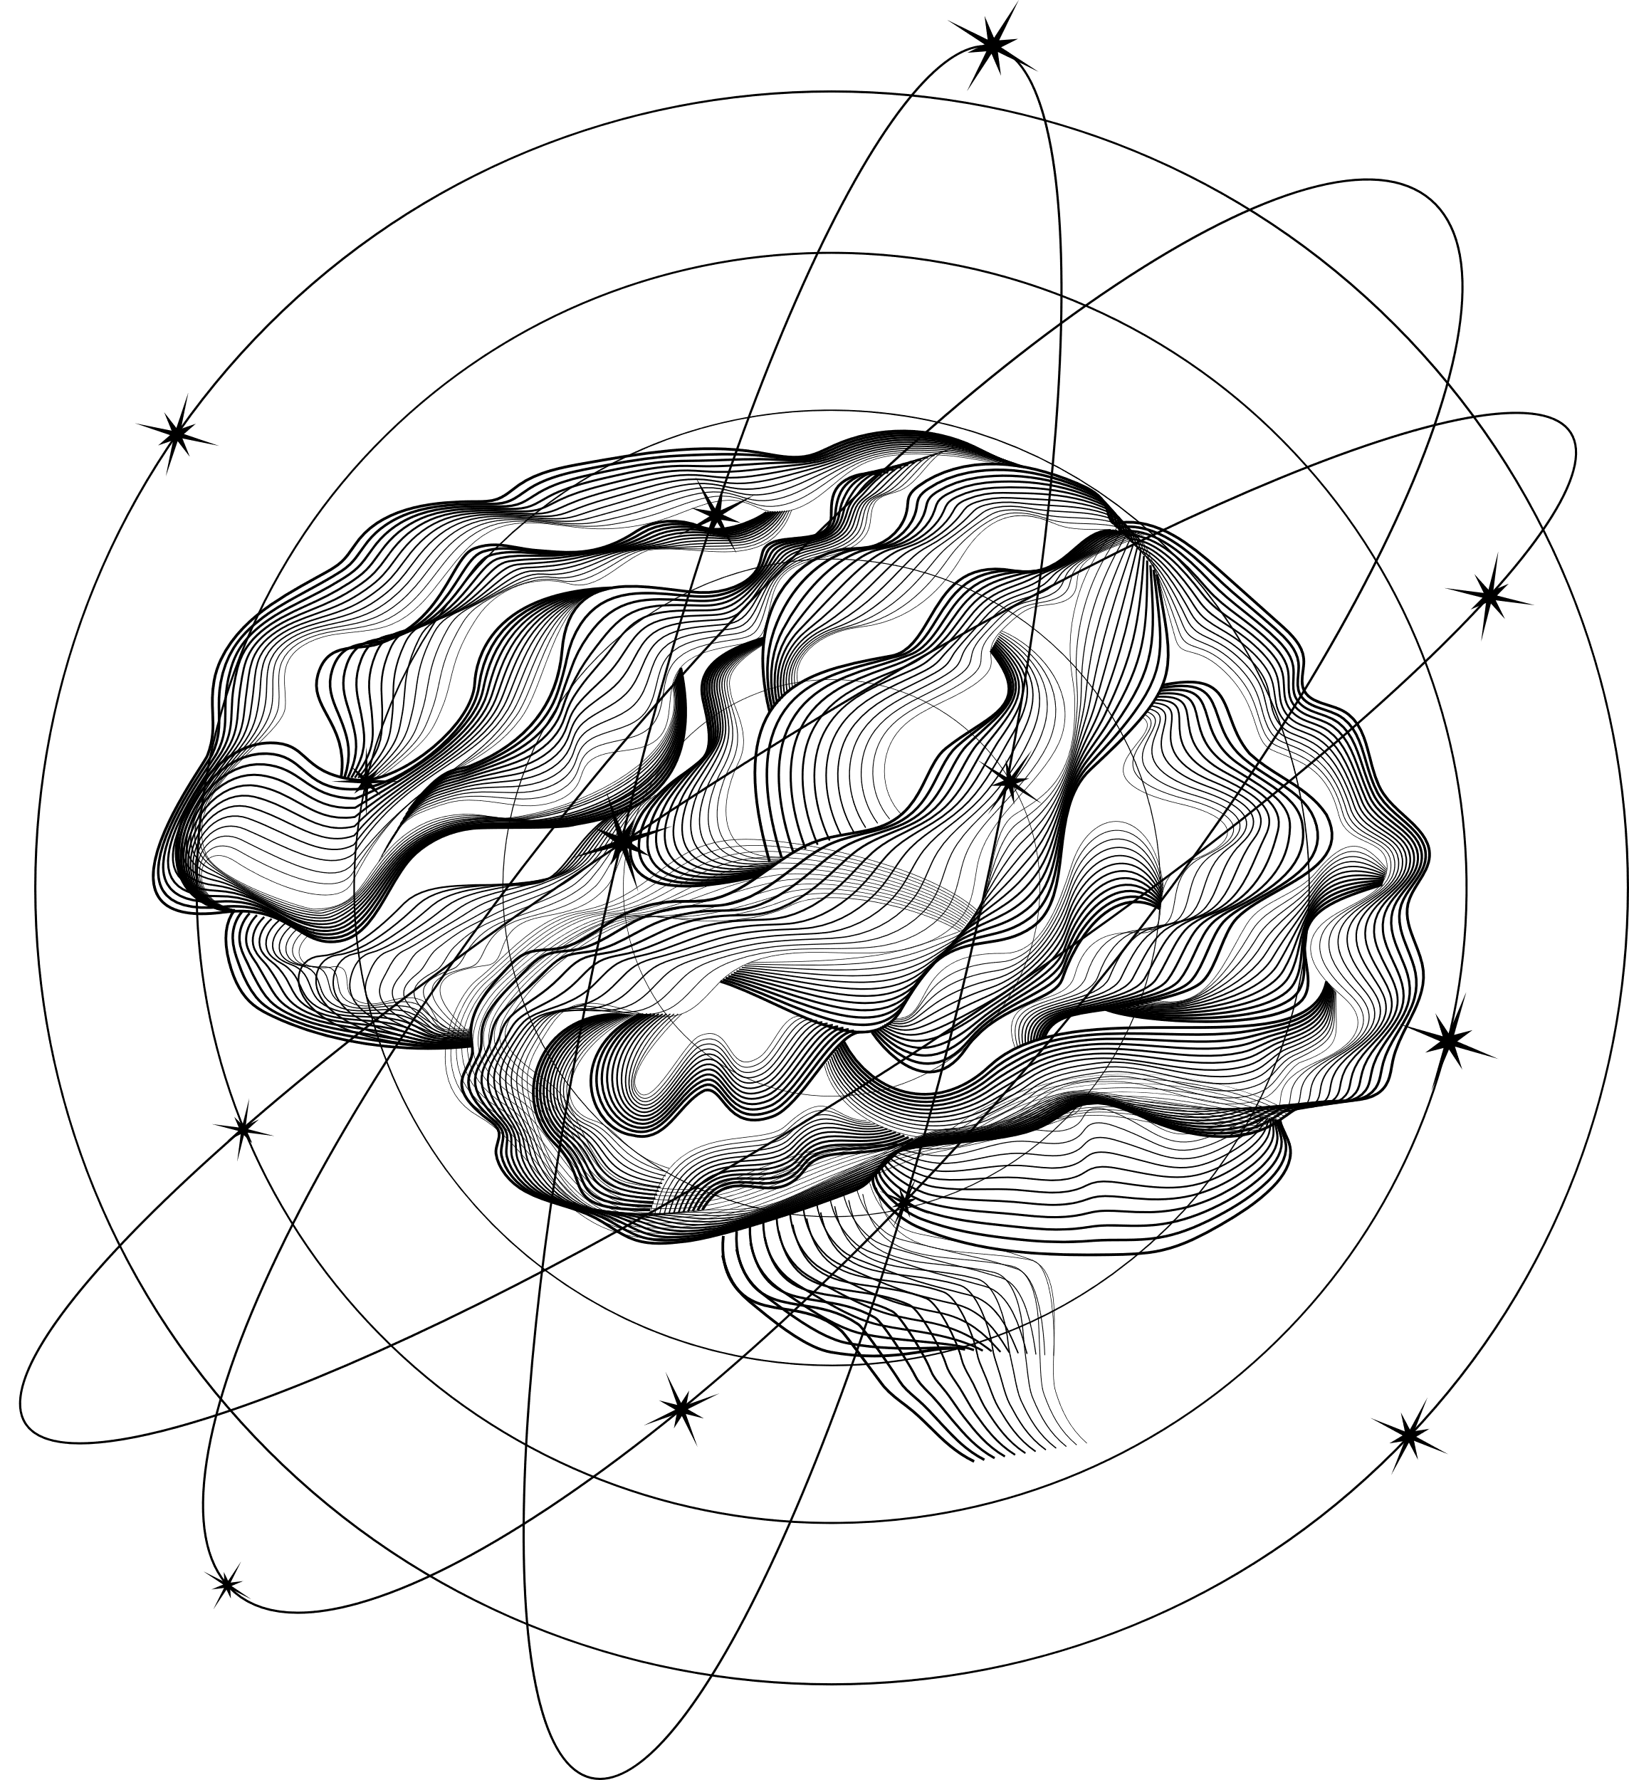
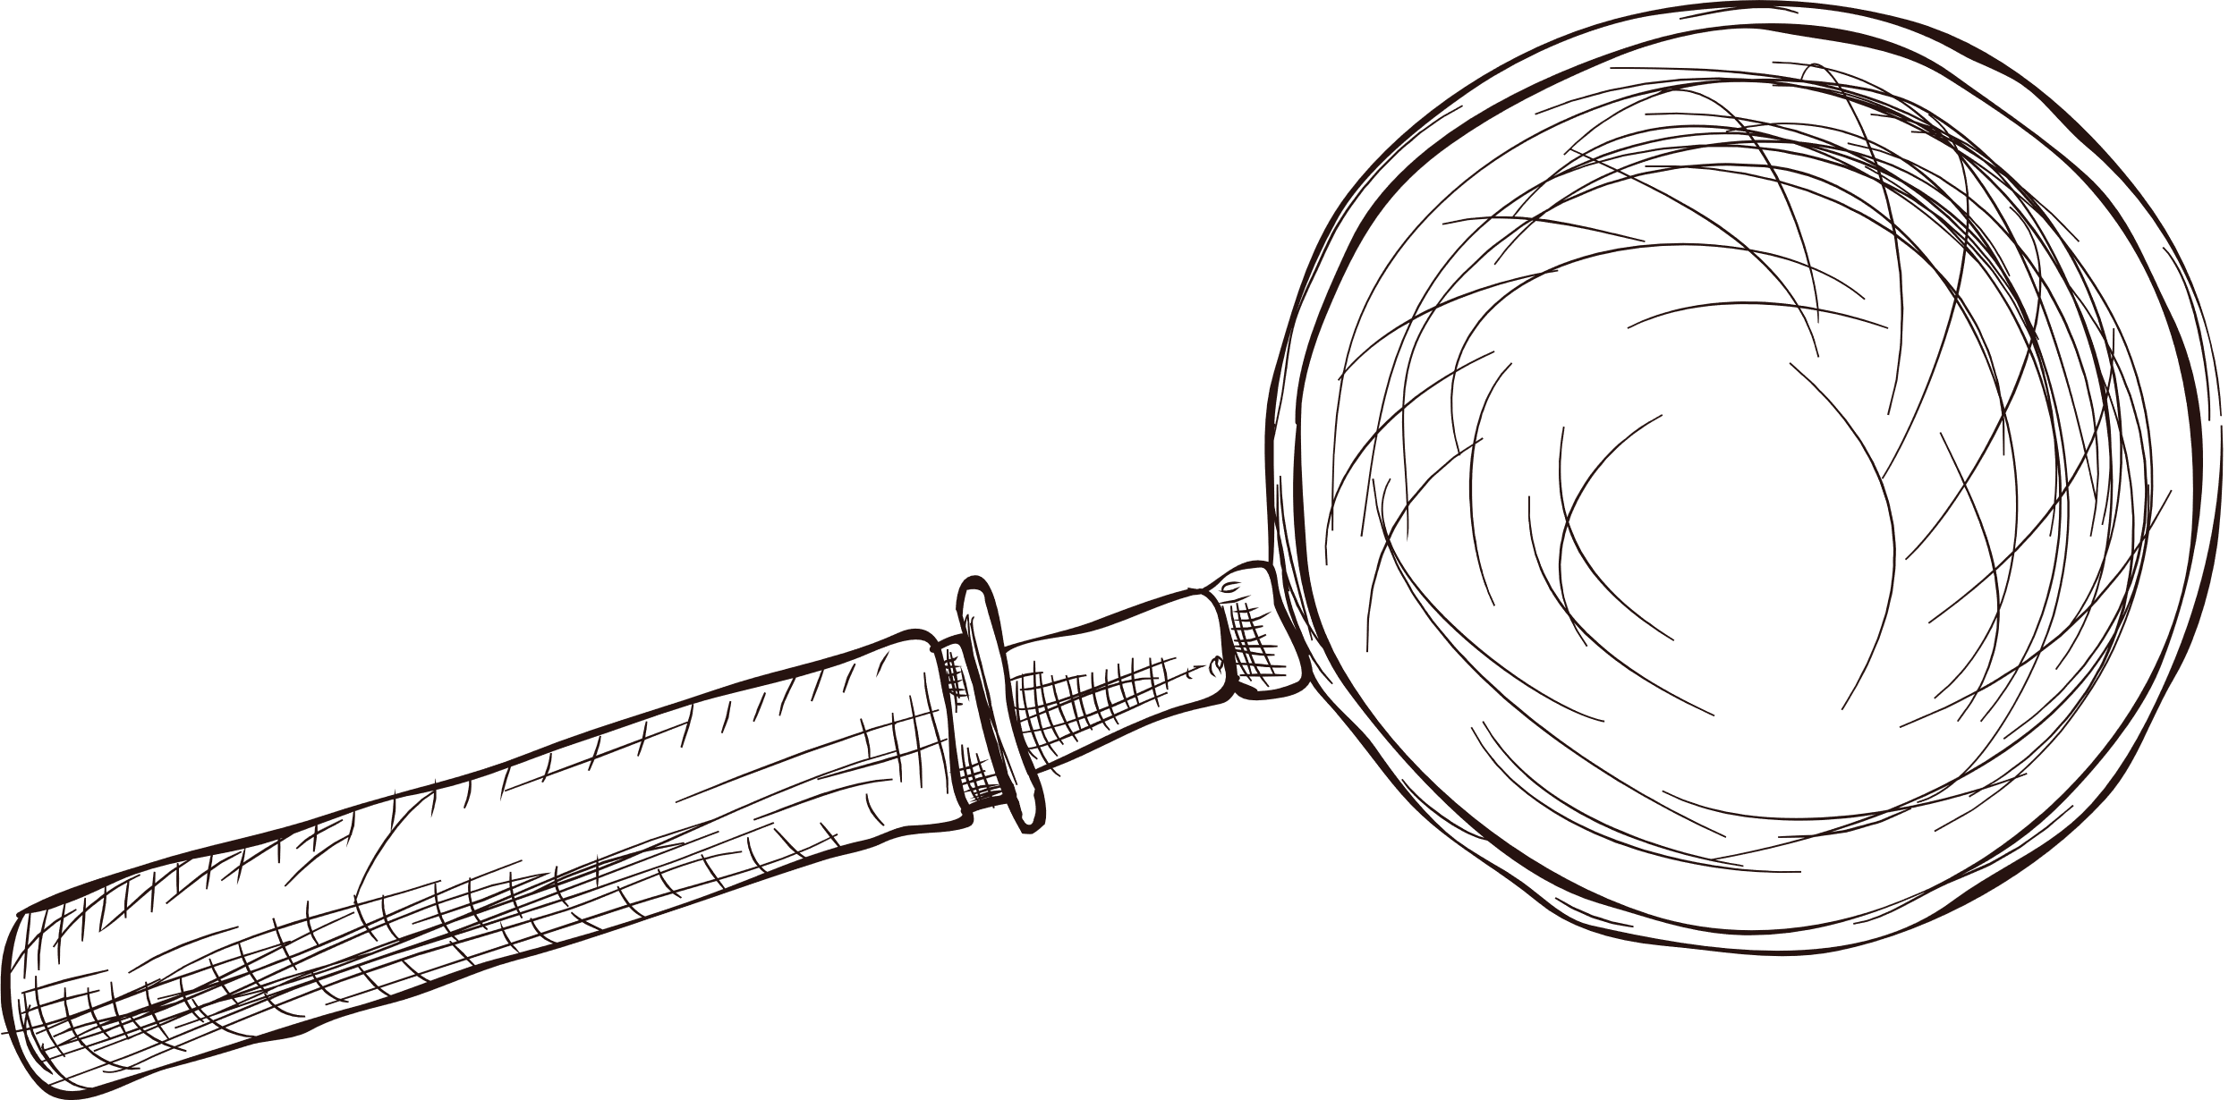

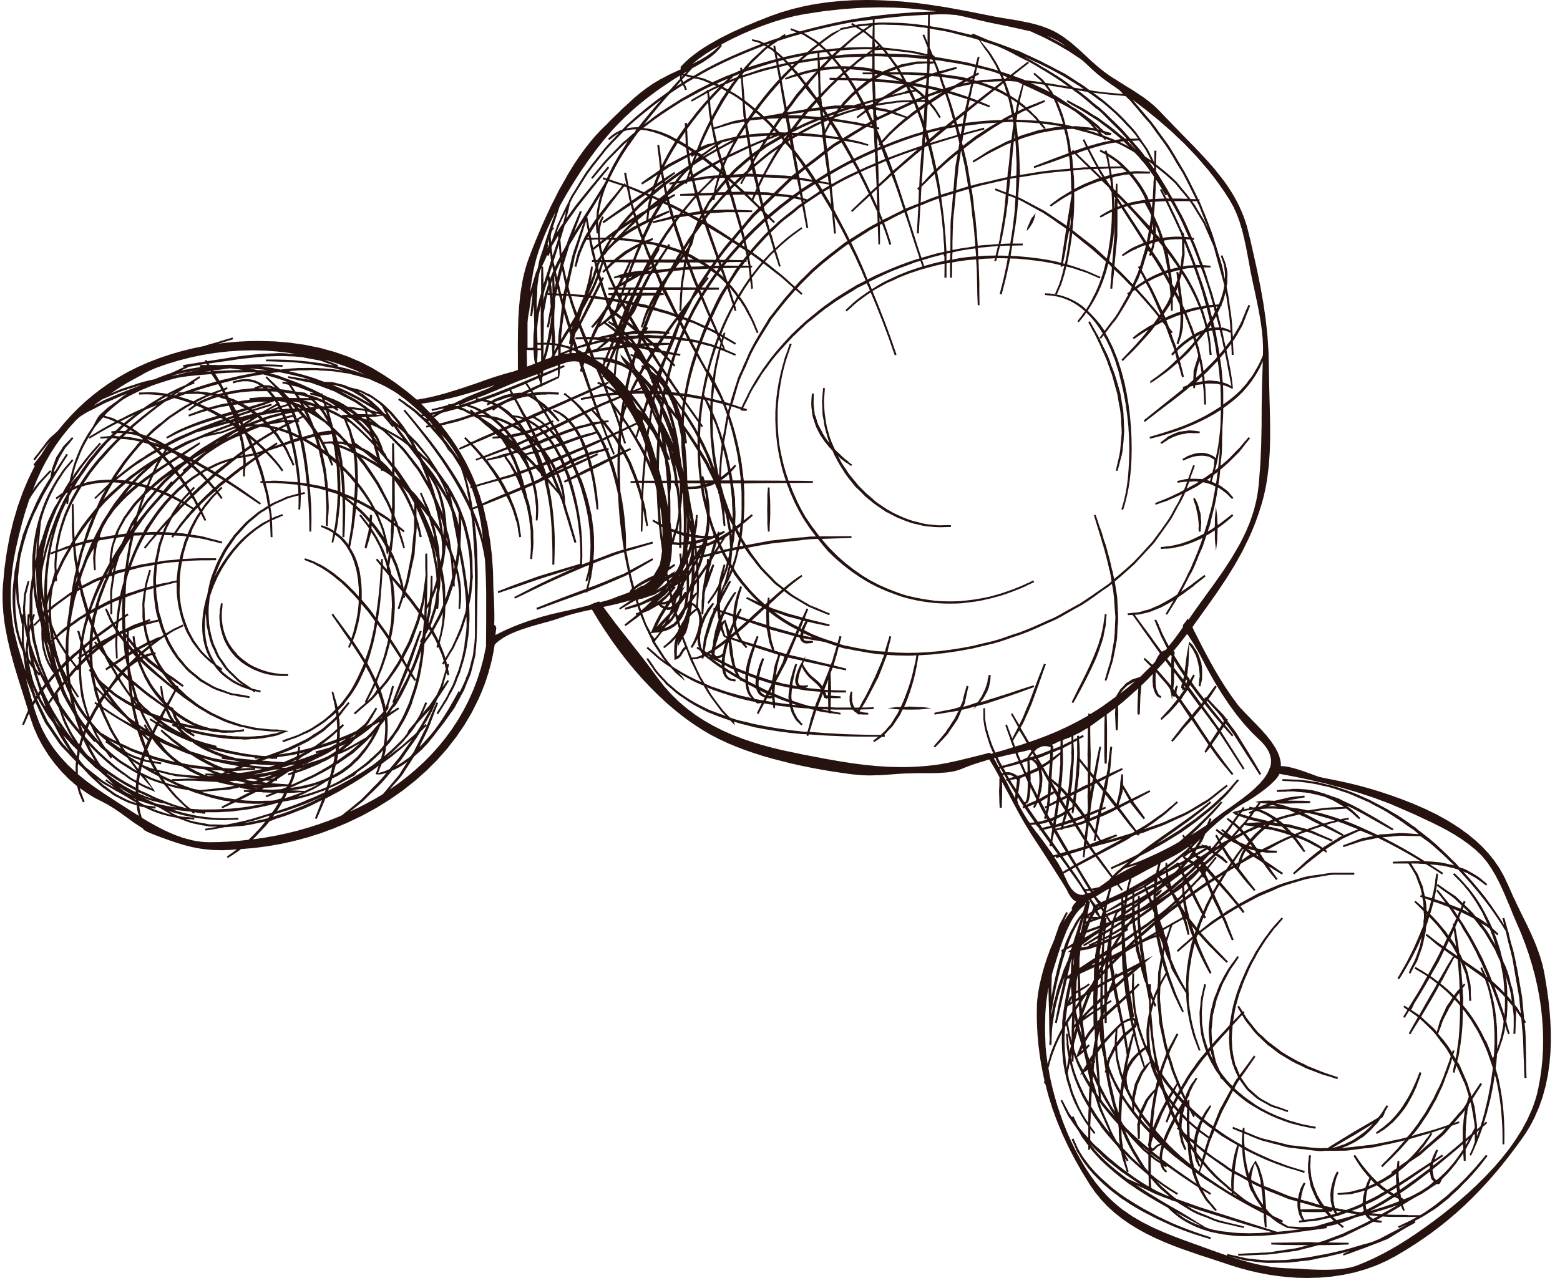
Original Research
EXPLAINABLE AI IN HEALTHCARE: INTERPRETING MACHINE LEARNING’S DEMENTIA CLASSIFICATION ON Imbalanced Multi-Domain Clinical Data
Presented by Anh Ngo

Slide 2
01
Introduction
02
Materials and Methods
Agenda
03
Main Findings
04
Challenges
05
Future Directions

Slide 3
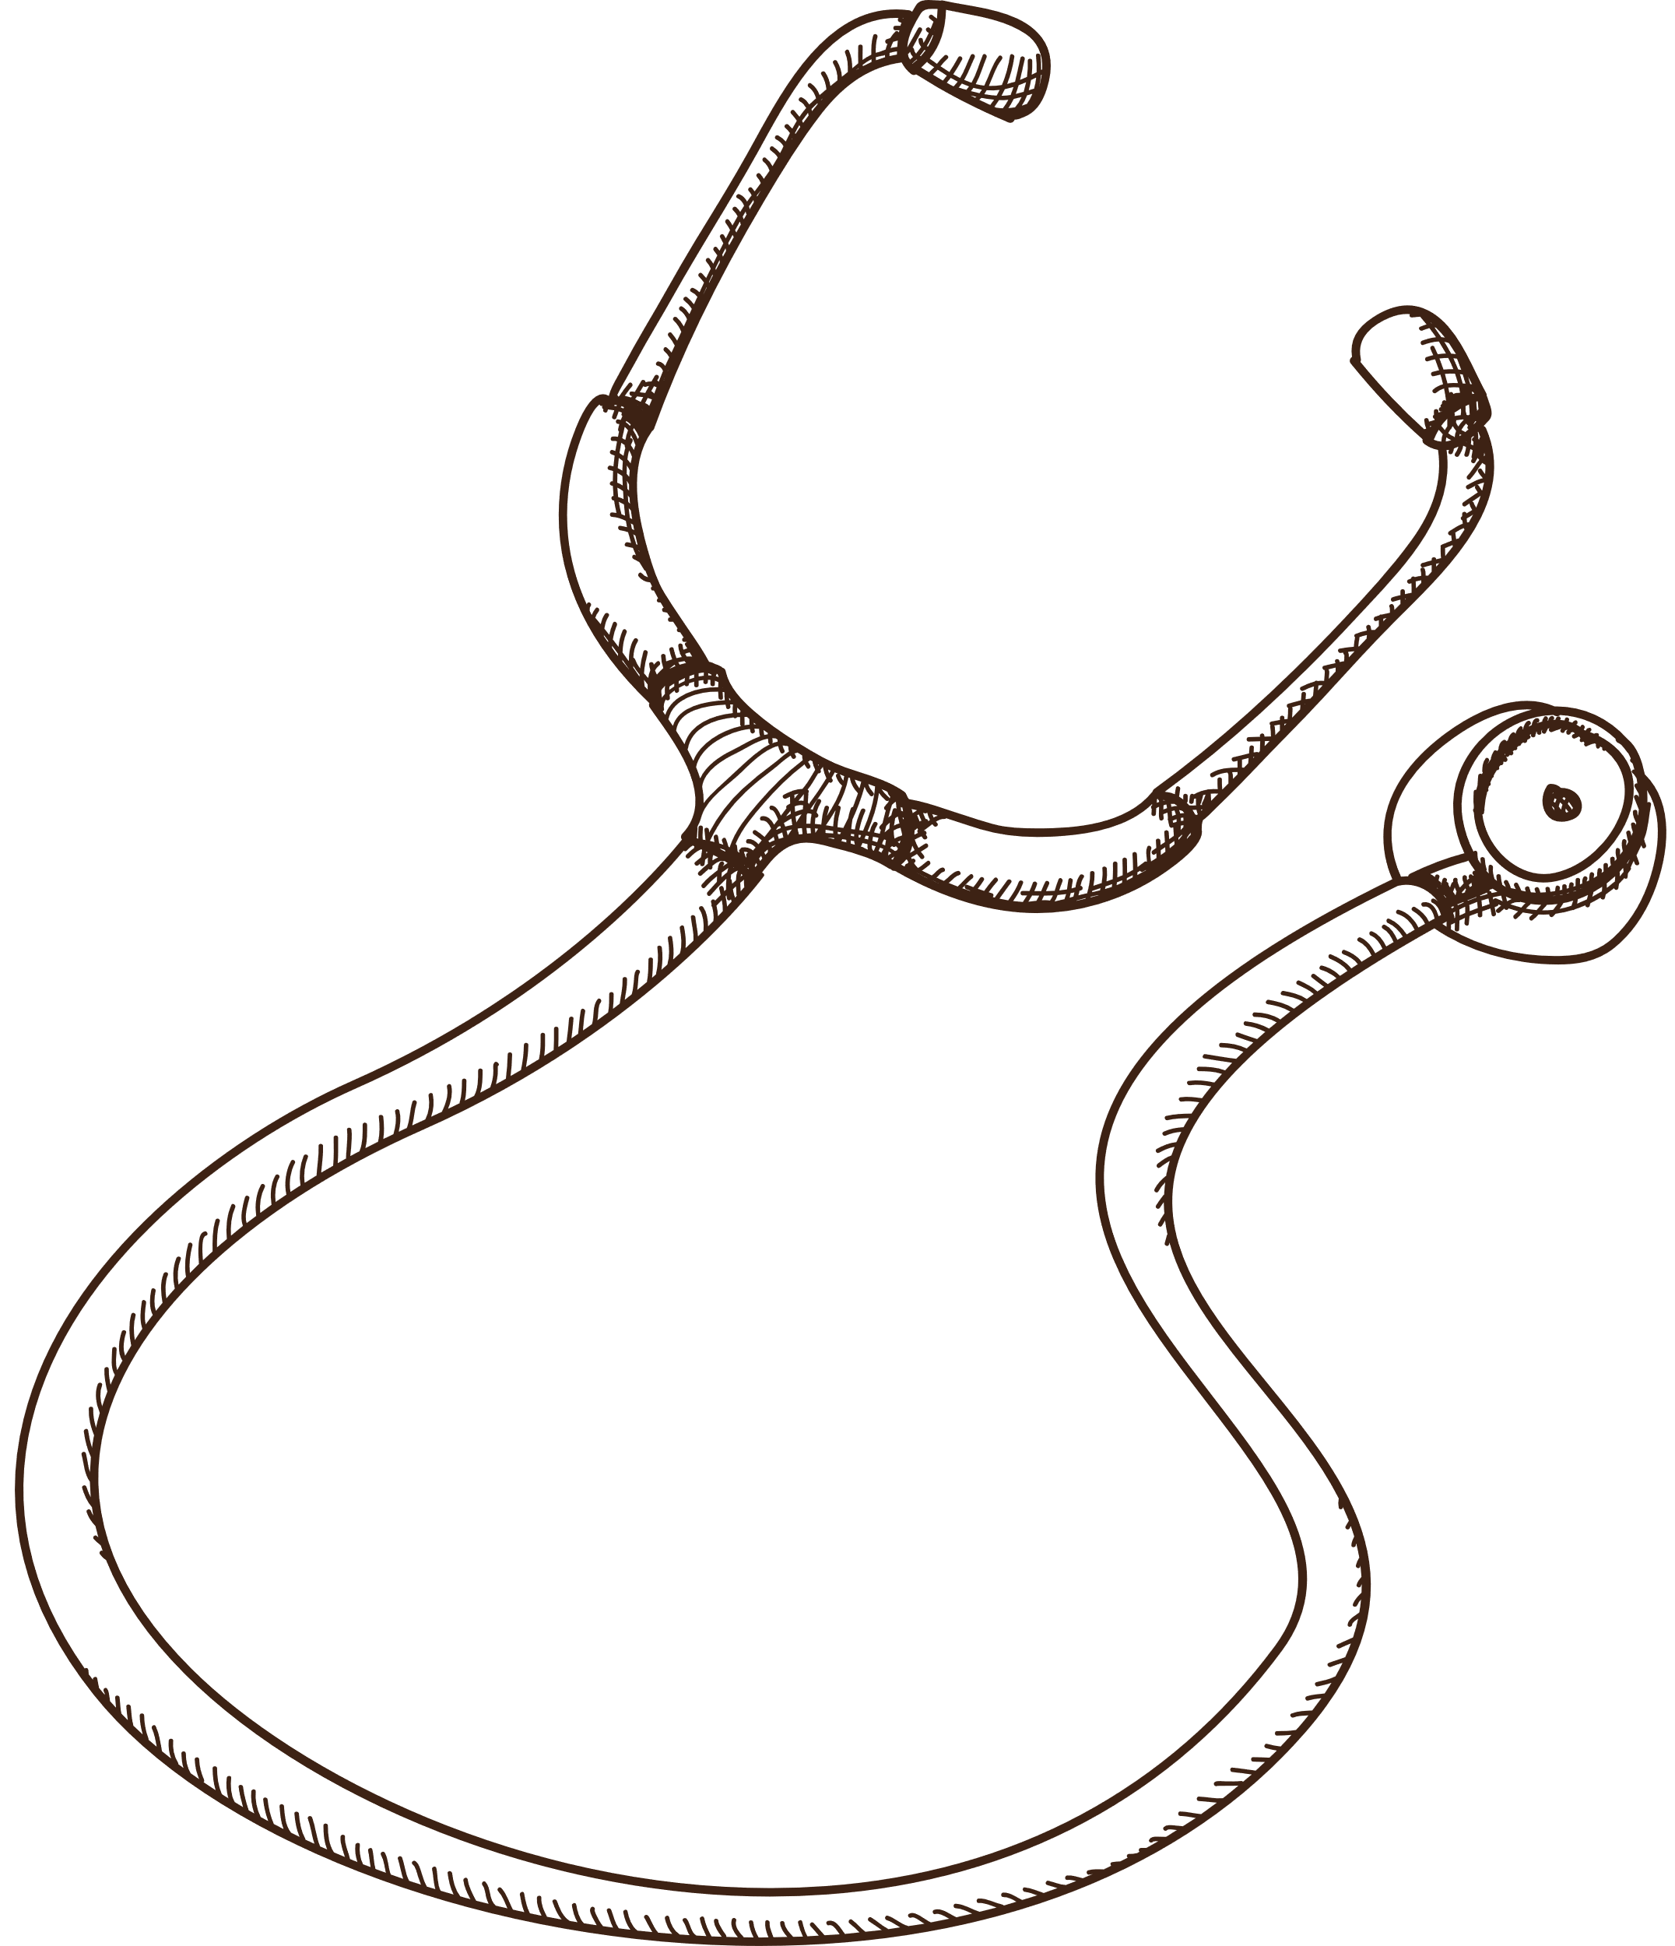
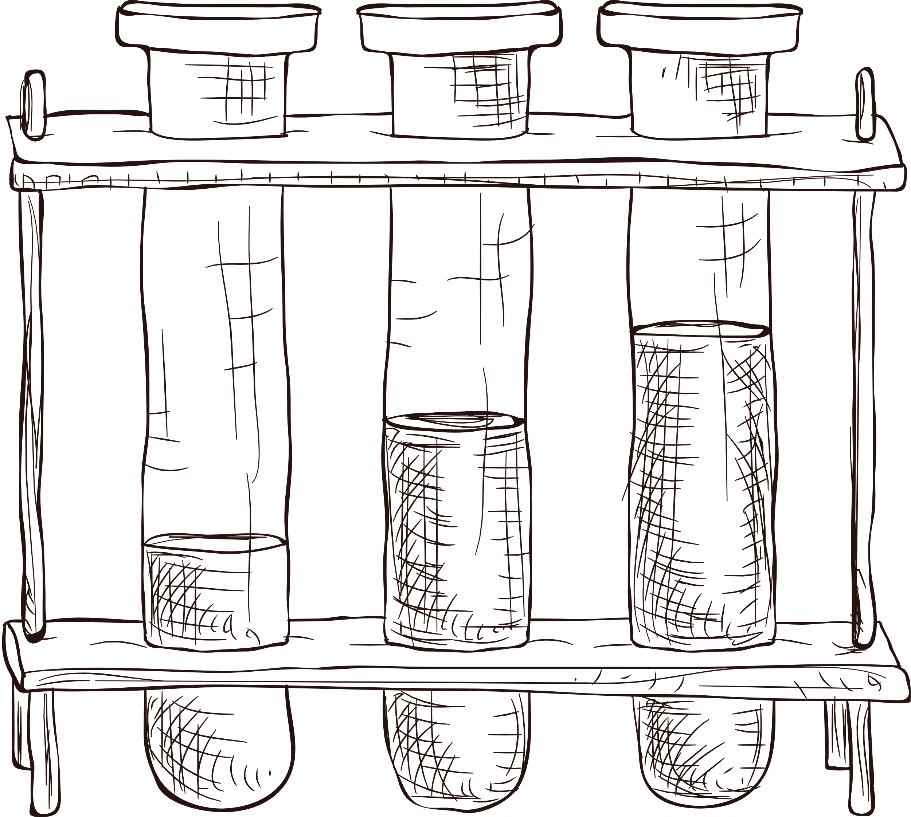
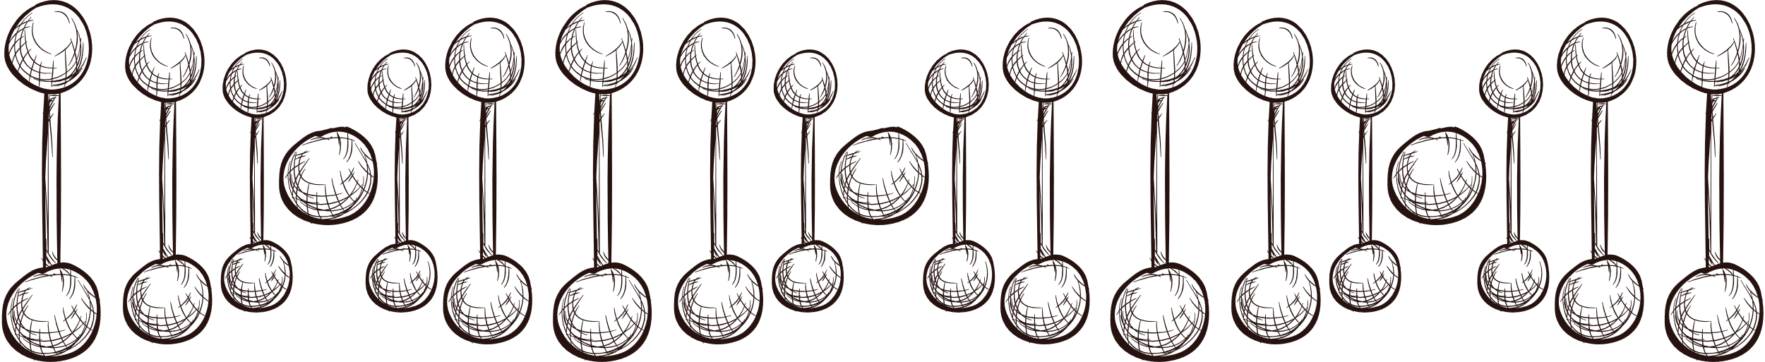
Introduction
Dementia: diseases and medical conditions that affect the human brain and cause increasingly serious effects on patients’ physical, cognitive, and emotional health.
In 2019, the global annual societal costs of dementia were estimated at $1313.4 billion, including direct medical expenses (16%). Several dementia-related diseases, namely Alzheimer’s Disease, Parkinson’s Disease, and Huntington's Disease, are incurable and irreversible.

Slide 4
Introduction
Regardless of constant advancements, automatic AI-powered predictive tools have not received considerable implementation in real-time contexts. The main reasons for this include: the limited range of factors considered by the models in predicting dementia and the lack of interpretability, or unclear rationale behind their decisions.

Slide 5

The
research
Demonstrate the superiority of Machine Learning models in detecting dementia when trained on multi-domain data
01
Identify an optimal model among 4 ML models for classification on a multi-domain dataset with class imbalance.
02
Apply Explainable AI (XAI) to interepret the contribution of each feature to the best model’s decision.
03

Slide 6

Methodology
Data
The dataset used for this study is the adapted version of the Open Access Series of Imaging Studies 2 (OASIS-2), which records the dementia prediction of 150 patients in 3 to 4 visits.. This adapted version excludes neuroimaging from the original dataset and increases its size by treating each visit as a seperate instance without their ID.

Slide 7
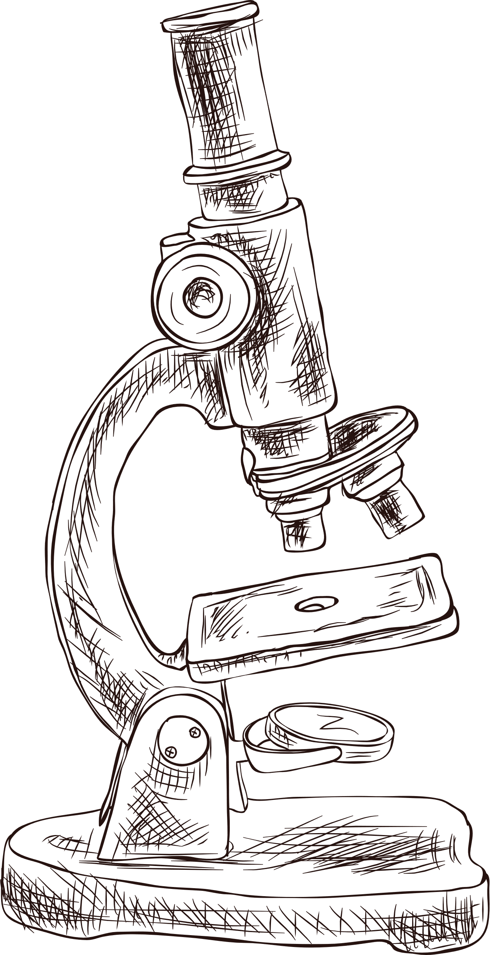
Evaluation Metrics
Accuracy
Precision: How accurate the prediction of the model for a class is
Recall: How well the model captures all instances of a class
F1-Score: Harmonious average between Recall and Precision
To finalize the general prediction results based on the results of each class, we applied macro averaging and weighted averaging.

Slide 8
Models
Single Models
Ensemble Models
K-Nearest-Neighbor (KNN):
Classify an instance based on the most-occuring class within k neighbor instances.
In this study: GridSearchCV
Random Forest Classifier (RF):
An ensemble of multiple Decision Trees trained on different subsets of a dataset.
Extreme Gradient Boosting (XGB):
Also an ensemble of Decision Trees but the trees are trained one after another to minimize the prediction loss.
Support Vector Machine (SVM):
Group/Split instances while balancing between accuracy and sensitivity to outliers
In this study: RBF Kernel
In this study: Ensemble models tackle class imbalance

Slide 9
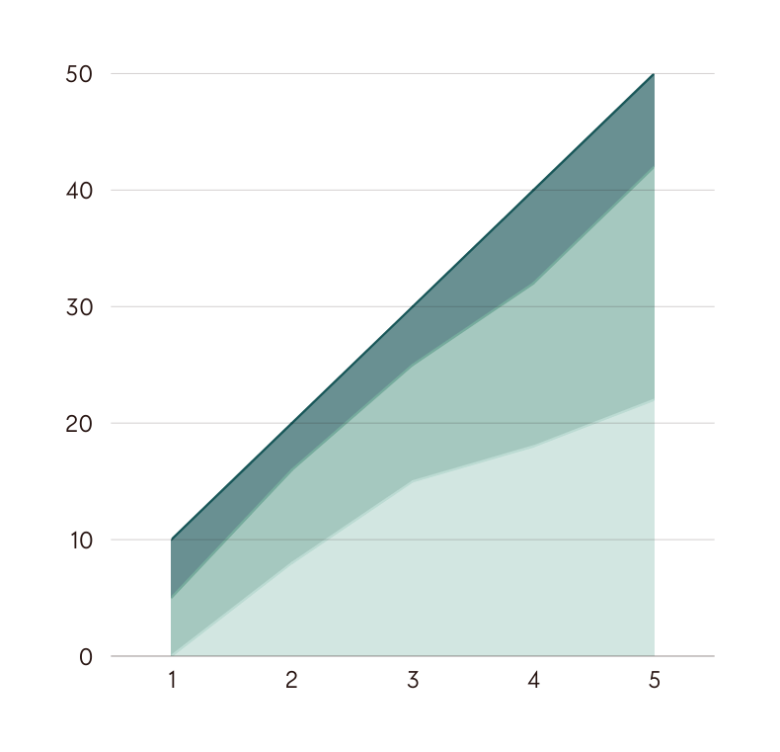
Results Interpretation
After identifying the best-performing model, we applied SHAP - an Explainable AI (xAI) technique to interpret the importance of each feature in the models’ classification.
SHAP: quantifying the contribution of a feature through the difference in prediction results (probability distribution of a class) with and without that feature in the dataset.

Slide 10
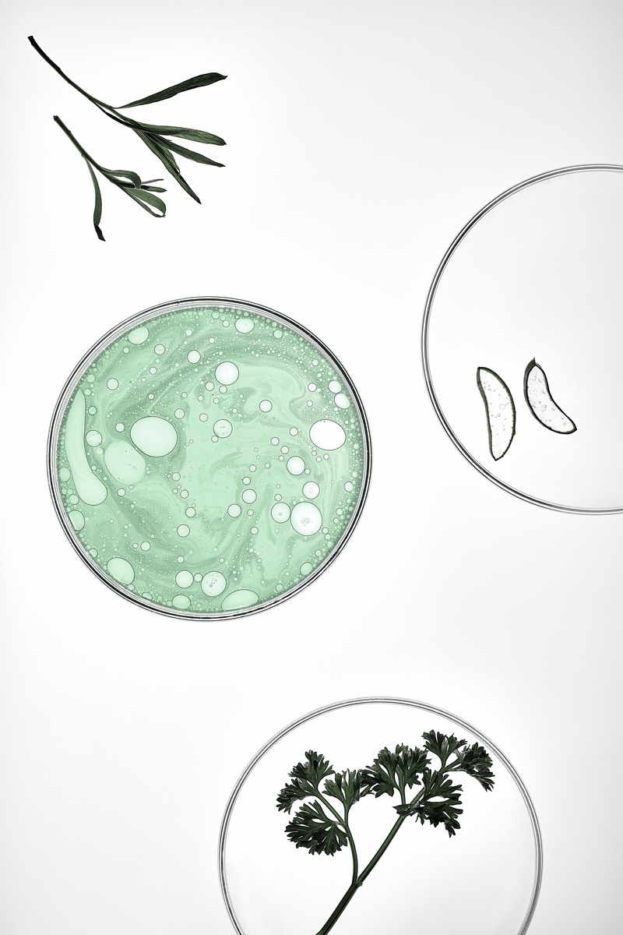
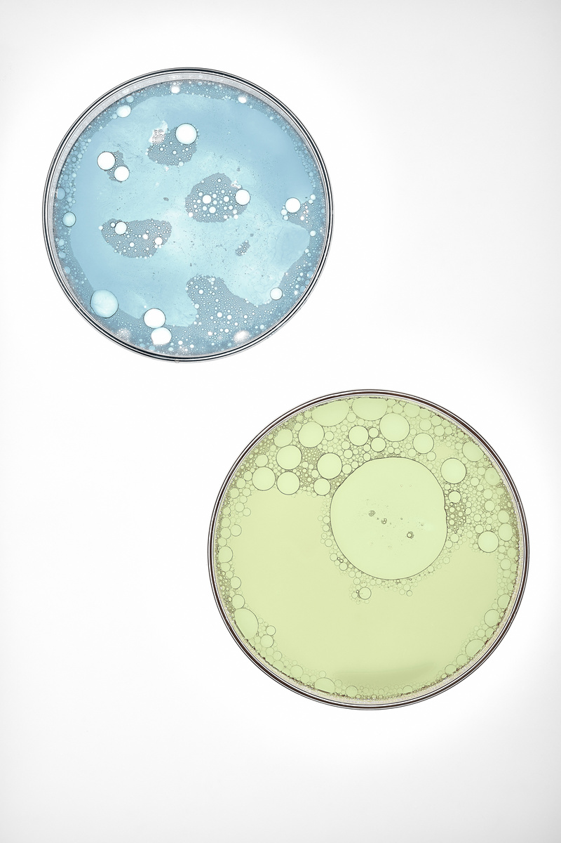

Main Findings
Phase 1
Phase 2
The RF performs best when trained on the multi-domain dataset.
RF is the best-performing model in prediction, followed by XGBoost, KNN and SVM, respectively.
Phase 3
Conclusion
MMSE Test Scores and Normalized Whole Brain Volume are the clearest indicators of dementia
Domain variety boosts prediction results
RF is the best in dealing with class imbalance
Model’s rationale aligns with ground truth

Slide 11
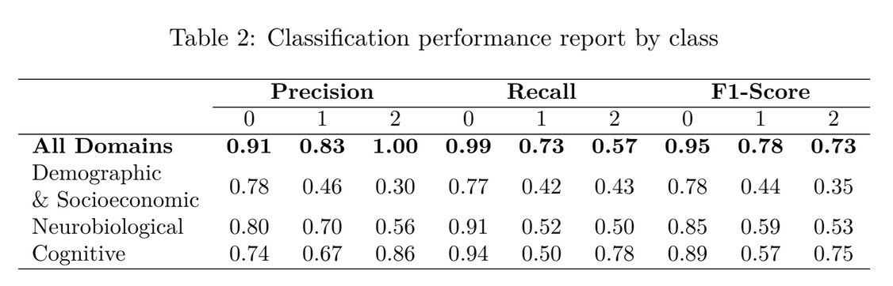
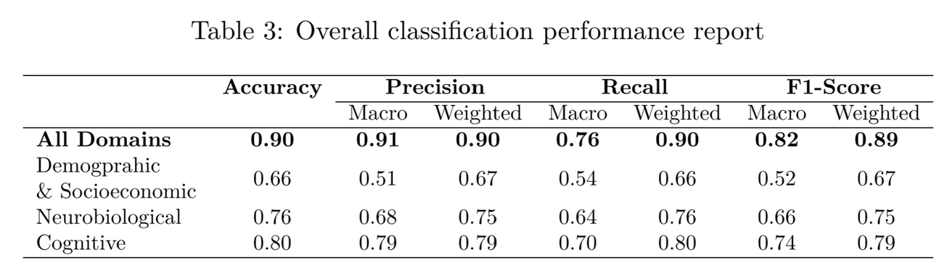
Phase 1
To evaluate the importance of domain variety in ML training, we first compared the rprediction results of the RF for each class on different sets of data
In detecting every class, the RF witnessed an increased performance in all evaluation metrics.
Similarly, when concluding the overall performance of the model, we also noticed that the domain variety significantly boosted the model’s performance, up to around 90% for all metrics after weighted averaging.

Slide 12
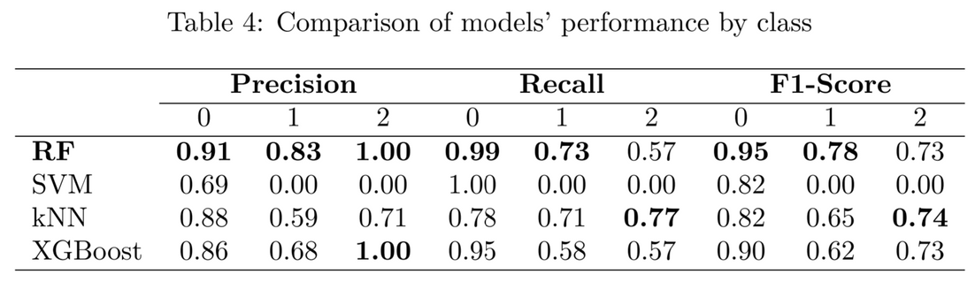
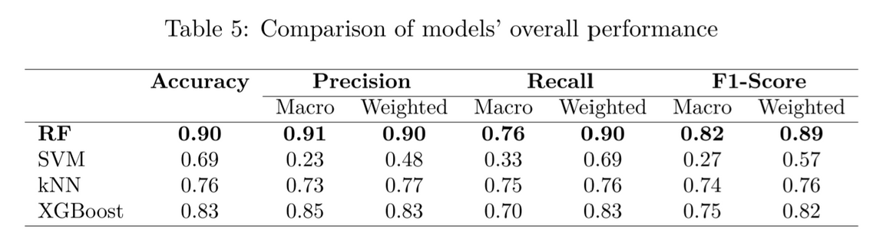
Phase 2
In analyzing the prediction results for each class, we noticed that the benchmark RF has superior performance in most cases.
Surprisingly, kNN was the best in classifying class 2, the most minored class. This might be because the statistics for class-2 instances were closely related to each other and clearly different from the other classes, so the neighbor searching was more efficient.
Regarding the overall results, the RF classifier achieved the best performance.

Slide 13
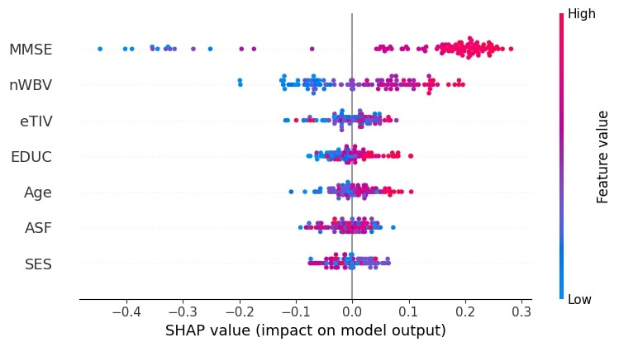
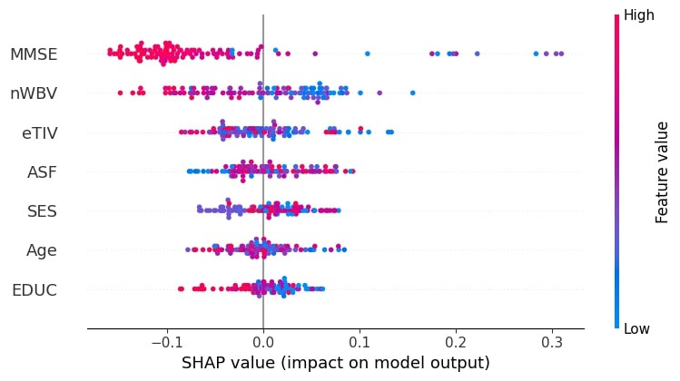
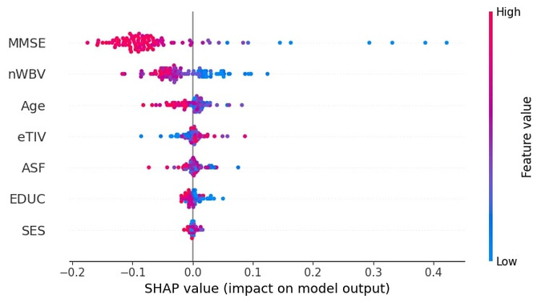
Phase 3
In all classes, MMSE Score and Normalized Whole Brain Volume (nWBV) are the 2 features that have the biggest impact on the model’s decision-making.
Higher MMSE score and nWBV tend to lead the model classify a subject as non-demented (class 0). Contrariwise, middle or low MMSE and nWBV leads to the classification of class 1 or 2. Educational level (EDUC), while having less impact, also imposes the same pattern.
These tendencies in model’s decision-making align with the ground truths used in dementia prediction.

Slide 14
01
Gap identifying in existing knowledge
Challenges
02
Class imbalance handling
03
Literature search to intepret experiment results

Slide 15
Conclusions
01
02
03
Domain variety boosts prediction results, gaining the RF 90% accuracy and over 80% in other metrics.
RF is the best performing model with the highest score in most metrics, followed by XGBoost.
The SHAP analysis implies that the model’s decision-making aligns with ground truth about dementia risk.

Slide 16
Future Directions
01
02
03
Apply additional methods for handling the class imbalance: SMOTE, Undersampling, Oversampling
Develop into a longitudinal study: integrate progression prediction with disease classification
Combine multi-domain and multimodal data: predict on statistical data, natural language, and brain scans

Slide 17
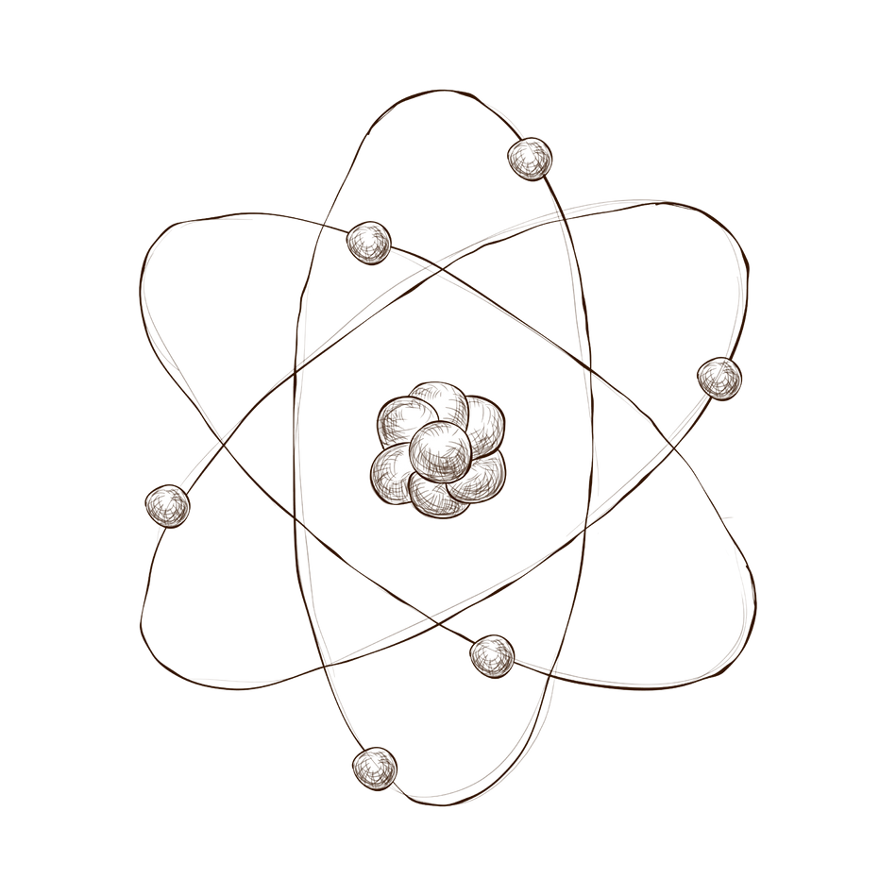
Thank
you!
Do you have any questions?
ngotuananh10906@gmail.com

